Slide 1
The Implementation and Application of Multiclass Belief Propagation on Hadoop
Guanyu Wang
Yuchen Tian
Yu Su
Huanchen Zhang
Institute for Software Research
Carnegie Mellon UNIVERSITY

Slide 2
Outline
Introduction & Goal
Proposed Method
Experiment
Conclusion

Slide 3
Introduction
Belief propagation, also known as sum-product message passing is a message passing algorithm for performing inference on graphical models, such as Bayesian networks and Markov random fields.
Fast Belief propagation , which was first proposed by Koutra, et al. Based on the “about-half” assumption and Maclaurin expansion of logarithm, FastBP can quickly approximate the BP without repeated message passing process. But the FastBP Method can only used on two-class case.

Slide 4
Goal
Implement Multiclass BP on Hadoop
Apply BP, FastBP on Large Graph (different datasets)
Tencent Weibo network dataset
Amazon Co-purchase network dataset
Flicker Sharing dataset
DBLP dataset
Research on extending FastBP to Multi-class Problem
Study the convergence of BP
How to detect convergence
How to help BP converge

Slide 5
Proposed Method
Implement convergence detection on PEGASUS BP
Compare the each message between different iterations and set a threshold to detect whether the messages converge.
Implement message smoothing to help BP converge
Take the weighted average of the message updates and message of previous iteration to smooth the message updating process.
Use one-vs-all method to extend FastBP to multi-class
Use ECOC method to extend FastBP to multi-class

Slide 6
Proposed Method
Extend FastBP to Multi-class Problem
Use the assumption that correlation matrix is close to an identity matrix
Use the slack variables to relax the relation between any nodes and its sending and received message.
Use KKT conditions for formulated optimization problem to derive a equation system, which provides the final approximation of BP.
Use quadratic approximation instead of Maclaurin approximation to remove the “about-half” assumption.

Slide 7
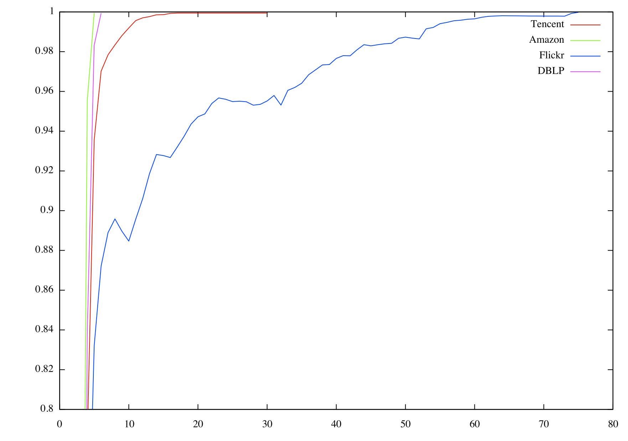
Experiments
Convergence Detection

Slide 8
Experiments
Run general BP, FastBP, Multi-class FastBP on following datasets: Amazon, Flickr, DBLP, Tencent.
Datasets | BP | OVA | ECOC
DBLP | 0.17 | 0.776 | 0.726
Flickr | 0.653 | 0.421 | 0.13
Tencent | 0.953 | 0.961 | 0.924
Amazon | 0.763 | 0.636 | 0.626

Slide 9
Conclusion
We implemented Convergence Detection and Message Smoothing.
We designed and run one-vs-all and ECOC to extend FastBP to mul-ticlass.
BP on multi-class can be approximated efficient with good accuracy when the correlation matrix is close to an identity matrix.
Experiment

